Slide 1
AI@Penn

Slide 2
Introduction
Purpose: equip students with ability to harness AI technology, and apply it to real-world scenarios to improve, progress or better their lives or the lives of others
Approach: learn how an algorithm works, and apply it to real life situation.

Slide 3
Overview of next few weeks
Session 1:
Session 2:
Intersperse with guest lectures, industry scopes, practical project lessons (eg. OpenCV, iPhone applications, recommender systems).

Slide 4
Today’s plan
Learn about the core, underlying problem of Machine Learning
Set up programming environment - Google Cloud
Program logistic regression algorithm
Gain intuitive insight to algorithm

Slide 5
Machine Learning & Artificial Intelligence
Machine Learning uses statistical techniques to give computer systems the ability to "learn" (i.e., progressively improve performance on a specific task) with data, without being explicitly programmed.
Artificial Intelligence is the theory and development of computer systems able to perform tasks normally requiring human intelligence, such as visual perception, speech recognition, decision-making, and translation between languages.
ML ⊆ AI
Why now? → more data, greater CPU power, better algorithms
Subfields + Applications: Computer Vision (medical image diagnosis), Natural Language Processing (chatbots), Boltzmann Machines (recommender systems), GANs (image/video generation)

Slide 6
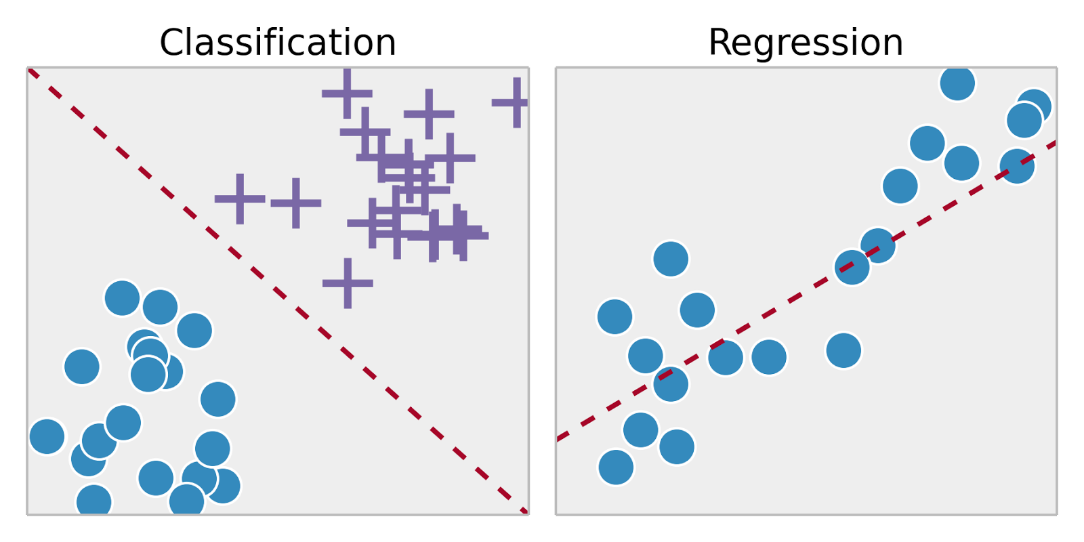
Classification vs Regression Tasks
Supervised: labelled data (eg. house prices), Unsupervised: unlabelled data (eg. bank customer data)
Classification: predicting discrete outcome (eg. handwritten digit), Regression: predicting continuous outcome (eg. house prices)
Classification requires distinct sets, and each piece of training data must belong to one

Slide 7
Process of Supervised Machine Learning
Compile/find dataset → example social media advertisement success dataset (instances, features, output value, predicted value)
Split dataset into train and test
Create algorithm framework
Feed data from dataset to algorithm using training data (training phase)
Evaluate performance of algorithm using test data (testing phase)

Slide 8
Programming Environment Setup
Google Collab: https://colab.research.google.com/
New Python 3 notebook
Allows for note-taking on the document
Efficient running of programs
Inbuilt libraries

Slide 9
Social Media Advertisement Prediction Algorithm
Import libraries
Read data
Separate into features and output values
Train-test split
Feed data into algorithm to train
Test performance

Slide 10
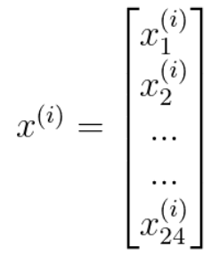
Logistic Regression (I)
In essence, an optimal, weighted summation of all the features
Example of this weighting
Dataset represented as:
Feature vector for single training instance i:
Output value: 0 (no cancer) or 1 (cancer)

Slide 11
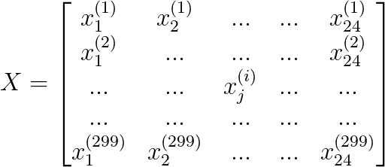
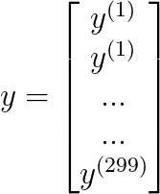
Logistic Regression (II)
Dataset now split up and represented as matrix:
Logistic Regression predicts probabilities rather than the actual value (eg. difference between strong vs weak prediction)
If (ŷ > 0.5), predict 1, or else predict 0

Slide 12
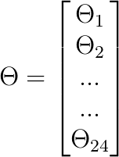
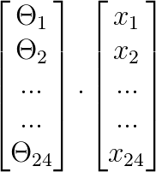
Logistic Regression (III)
Weightings stored in weights vector:
To get weighted sum, utilize dot product (represented as Θ^{T}x)

Slide 13
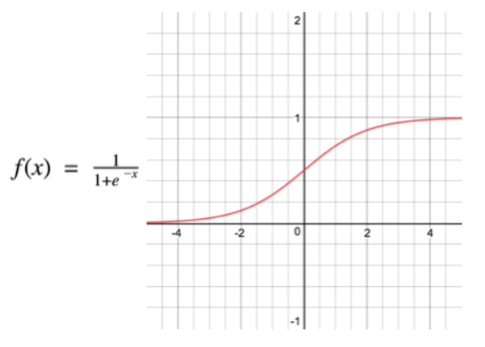
Logistic Regression (IV)
However, this gives an infinite result
Thus, sigmoid function utilized to bound output to be between 0 and 1 (like any regular probability)
High weighted sum → high probability
Low weighted sum → low probability
Weighted sum = 0 → 0.5 probability
The input to the function is the weighted sum, Θ^{T}x
So f(x) is represented as….

Slide 14
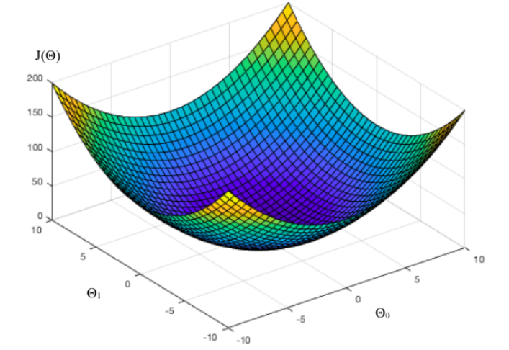
Logistic Regression (V)
Utilize h_{Θ}(x) instead, since weighted sum is dependent on values in Θ
How do we find the ideal values for Θ?
First, gauge how well the model does → Cost Function
Mean Squared Error function parameterized by all variables in Θ → can be seen as a graph in many dimensions, which each dimension representing a weight

Slide 15
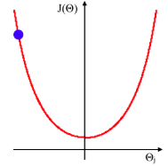
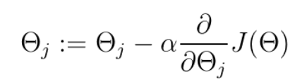
Logistic Regression (VI)
Single dimension:
Find minima for each dimension, differentiate for it? No → too computationally expensive.
Rather, find gradient, and subtract it from current value (times the learning rate)

Slide 16
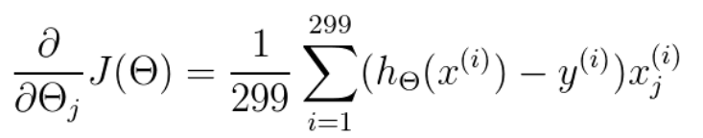
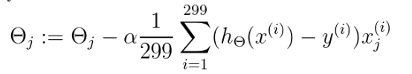
Logistic Regression (VII)
Comes out as:
Therefore:
Repeat many times for each weight, or until you find ideal weights (i.e. they don’t change anymore)!

